Slide 1
Migrating Legacy Public Folders to Modern Public Folders
stensitzki

Slide 2

Thomas Stensitzki
Owner | Enterprise Consultant Granikos GmbH & Co. KG MVP | MCT | MCSM
Email: Thomas.Stensitzki@Granikos.eu Blog: http://blog.Stensitzki.de Twitter: @stensitzki

Slide 3
Agenda
The Public Folder Dilemma
Migration to Modern Public Folders
Conclusion

Slide 4
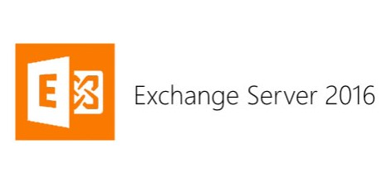


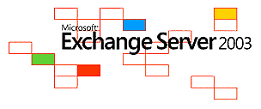



Exchange Server Questionnaire
Notes:
ACL = Access Control Lists

Slide 5
The Public Folder Dilemma
stensitzki
Notes:
Plage lagon Boucan Canot

Slide 6
Legacy Public Folders
Introduced with Exchange Server 4.0 in 1996
Provided business collaboration functions like email, calendars, to-do lists, contacts, discussion forums, file sharing, and even some sort of instant messaging
Access Control Lists to make public folders private
Available in all Exchange Server Versions up to Exchange Server 2010
Dedicated replication engine with multi-master functionality
Exchange Management Console for full management capabilities
Outlook for Windows is the primary client to access Public Folders
Notes:
ACL = Access Control Lists

Slide 7
Modern Public Folders
Introduced with Exchange Server 2013 in 2012
Major changes in how public folder data is stored an replicated
No Public Folder coexistence with Legacy Public Folders
No technical change in managing access to Public Folder content
Available in all modern Exchange Server Versions*
No multi-master replication
PowerShell as primary tool for managing Public Folders
Outlook for Windows is the primary client to access Public Folders
* Some restrictions apply in regard to supported sizes and limits
Notes:
ACL = Access Control Lists
Public Folder Limits: https://docs.microsoft.com/en-us/exchange/collaboration/public-folders/limits

Slide 8
Exchange Server 2010
Last Legacy Exchange Server Version supporting Legacy Public Folder
Coexistence with on-premises Exchange Server 2013 / 2016
Modern mailbox user can access Legacy Public Folders
Hybrid-Coexistence with Exchange Online
Exchange Online mailbox user can access on-premises Legacy Public Folders
Cannot coexist with upcoming release of Exchange Server 2019
End of Support
January 14th 2020
Notes:
https://blogs.technet.microsoft.com/exchange/2018/04/10/exchange-2010-end-of-support-is-coming/

Slide 9
What are your options?
Source Public Folder Version | Target Public Folder Version | Remarks
Exchange Server 2007 | Exchange Server 2010 Exchange Server 2013 | Exchange Server 2007 is End-of-Life and must be replaced Migrating to Exchange 2010 extends Legacy Public Folder lifetime
Exchange Server 2010 | Exchange Server 2013 Exchange Server 2016 Exchange Online | Migration to either on-premises Exchange Server or Exchange Online possible
Exchange Server 2013 | Exchange Server 2016 Exchange Online | Modern Public Folders can easily be migrated on-premises or to Exchange Online
Exchange Server 2016 | Exchange Online | Modern Public Folders can easily be migrated to Exchange Online
Notes:
https://docs.microsoft.com/en-us/Exchange/collaboration/public-folders/limits

Slide 10
Migration to Modern Public Folders
stensitzki

Slide 11
Prepare your Legacy Public Folders (1)
Upgrade to Exchange Server 2010 UR 8 or newer (UR 23 latest)
Check public folder replication of public folder databases
Cleanup public folders access control lists
Cleanup orphaned email activated public folder objects in Active Directory
Remove private attribute on all public folder objects
Reduce the number of public folders
Challenge the use of email enabled public folders
Notes:
It’s more a cleanup
Exchange 2010 UR 21: https://go.microsoft.com/fwlink/p/?LinkId=2003010

Slide 12
Prepare your Legacy Public Folders (2)
Update public folder names to exclude ‘\’, ‘/’ and leading/trailing spaces
Have OutlookAnywhere published to the Internet when migrating to Exchange Online
Have AutoDiscover published internally and externally
Notes:
It’s more a cleanup

Slide 13
Public Folder Migration Steps
Download an prepare the migration CSV Scripts
Cleanup any existing Public Folder migrations, if any exist
Prepare the modern Public Folder infrastructure
Create and start the migration batch
Monitor the migration batch and remove all issues
Finalize the migration batch → downtime for Public Folder access
Test access to modern Public Folders
Switch access to modern Public Folder → Point of no return
https://go.granikos.eu/MSPFBatchMigration
Notes:
It’s more a cleanup

Slide 14
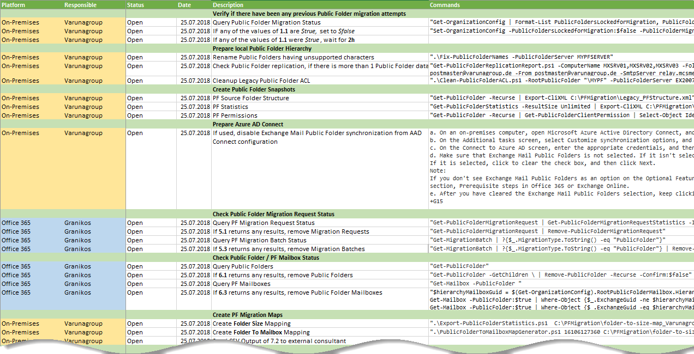
Public Folder Migration Action Plan
Notes:
https://go.granikos.eu/PFMigActionPlan

Slide 15
Migration to Exchange On-Premises
Exchange Organization
Public Folders
Exchange 2010 Multi-Role Server
Modern Public Folders
Exchange 2016 Mailbox Server

Slide 16
Migration to Exchange Online
Exchange Organization
Perimeter Network
Mailboxes
Migration Endpoint Config Public Folders
OutlookAnywhere
Public Folders
Exchange 2010 Multi-Role Server
Modern Public Folders
Migration Endpoint Config Mailbox Moves
Exchange Webservice
Modern Mailboxes
Exchange 2016 Coexistence Server

Slide 17
The Future of Public Folders
No plans to decommission modern public folders
Migrate public folders to Microsoft Teams
Review requirements for modern public folder usage and move content to other technologies
Notes:
It’s more a cleanup

Slide 18
Conclusion
stensitzki

Slide 19
Conclusion
Be prepared for the End-Of-Support for Exchange Server 2010
Know the limits of modern public folders
Reduce the number of legacy public folders to migrate
Remove orphaned information from Active Directory
Migrate to on-premises or online modern public folders
Move to modern technologies → Microsoft Teams
Notes:
Remember the date: January 14th, 2020

Slide 20


Slide 21
Slides: https://go.granikos.eu/aOSAachen2018
Email: Thomas.Stensitzki@Granikos.eu Blog: http://blog.Stensitzki.de Twitter: @stensitzki

Slide 22









Organizer
Diamond
Platinum

Slide 23
Ressources
Migration to Modern Public Folders – Notes from the Field
Migration von Legacy Public Foldern zu Exchange Online
Rename and Trim Legacy Public Folders for Modern Public Folder Migration
Public Folder Migration Action Plan
Public Folder Replication Report
PowerShell Community Scripts

